Slide 1


MATH SOCIETY

Slide 2
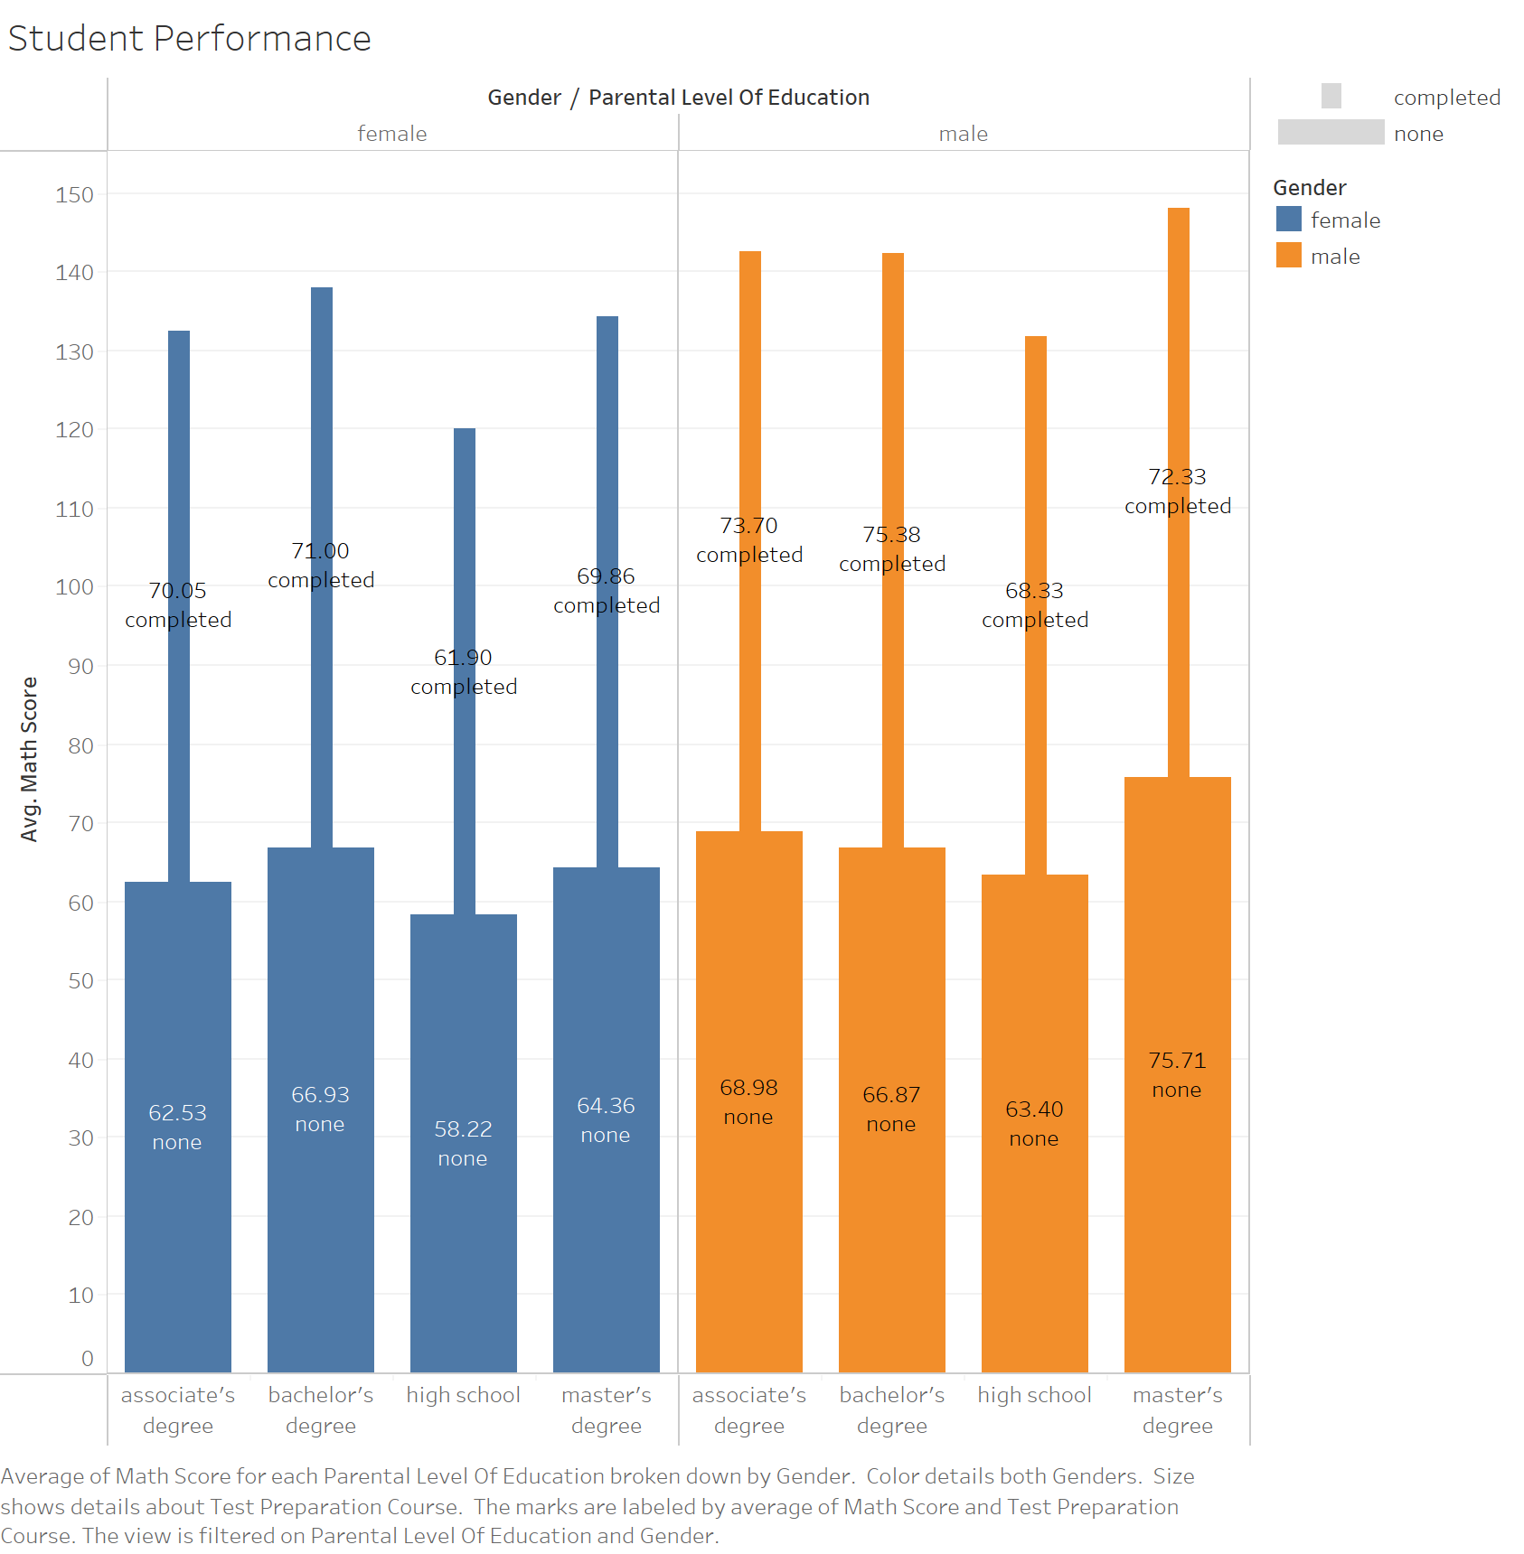
EXECUTIVE SUMMARY
Looking at the educational levels of both genders, their math scores, and preparatory class completion.
The male gender did outsmart the female in terms of preparatory course completion for each level of education. This led them to performing better than their female classmates
It is visually clear, above 50% in both genders did not complete the test preparation course and more so on the male side.
In addition, this data shows the female gender makes up the greater part of the student population. Using the mean shows a better representation of the math scores for both genders.
If more students completed the preparatory classes, an upward increase would be noted on their performance. Especially from the female side, as their average performance shows some few points shy from the males at every level.
Academic Measures
More students should show up and take preparatory classes seriously
Find the why and what can be done, to reduce the none completion levels in Master’s, associate and bachelor degrees
Grades are not written on stone, a student office should reach out to low grade students and find channels of encouragement
Impact of Measures
Increase academic focus on and off school
Deliver better grades and stand out in records
Areas where students face difficulties will be brought up, examined and thrashed
Build relationships between school and their various student levels
Eradicate the fear of math problems and raise confidence at each level
Implementations
Define a fit system to align with each level of education for better grades
Ensure preparatory class time does not conflict with the student’s activities out of school
Make every lecture material enriching and understandable to all

